Slide 1
t-test - unpaired
Testing for a difference
Notes:
If the data is paired, using paired t-test will get a better result

Slide 2
What does it do?
Tests for a difference in means
Compares two cases
(eg areas of lichen found in two locations)
Your two samples do not have to be the same size

Slide 3
Planning to use it?
Make sure that…
You have five or more values in each sample
Your data are normally distributed
Only continuous data (lengths, weights etc) can be normally distributed
You can do a check by seeing if your data look roughly like this:
If your data are not normal, use Mann-Whitney
If your data are also paired, use paired t-test
Notes:
If in doubt whether it’s normal, it’s better to use Mann-Whitney

Slide 4
How does it work?
You assume (null hypothesis) there is no difference between the two means
The test works by calculating the means and standard deviations of the two samples, and substituting into a formula.

Slide 5
Doing the test
These are the stages in doing the test:
Write down your hypotheses
Finding the means & standard deviation
Use the formula to calculate the t-value
Write down the degrees of freedom
Look at the tables
Make a decision
Click here for an example
Notes:
The underlined terms are hyperlinks to the appropriate slide

Slide 6
Hypotheses
H_{0:} mean1 = mean2
For H₁, you have a choice, depending on what alternative you were looking for.
H_{1:} mean1 > mean2
eg: Area of lichen in unpolluted location is greater than area of lichen in polluted location
or H_{1:} mean1 ≠ mean2
eg: Area of lichen in unpolluted location is different to area of lichen in polluted location
Unless you have a good biological reason for expecting one to be larger, you should choose “different” for H₁
Notes:
The form of the alternative hypothesis should be chosen before getting the data – to ensure there really is a good reason for 1-tailed version, if chosen.

Slide 7
Means & Standard Deviation
For each sample, find the mean by adding up all the values and dividing by how many there are
Find the estimate of the standard deviation s for the two samples, using the formula
n₁ and n₂ = sizes of the two samples
and = means of the two samples
Σx₁² and Σx₂² = sums of squares of sample values
Notes:
When putting this into a calculator, it’s best to work out the top and bottom separately, then divide, then square root final answer

Slide 8
Formula
Substitute your values into the formula
n₁ and n₂ = sizes of the two samples
and = means of the two samples
s = estimate of standard deviation
Notes:
There are other variants of this formula, but they come to the same thing

Slide 9
Degrees of freedom
The formula here for degrees of freedom is
degrees of freedom = n₁ + n₂ – 2
Where n₁, n₂ are the sample sizes
You do not need to worry about what this means –just make sure you know the formula!
But in case you’re interested – the fewer values you have, the more likely you are to get a large t-value by chance – so the higher your value has to be to be significant.

Slide 10
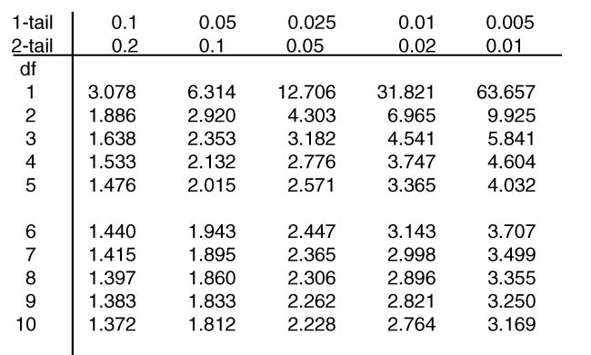
Tables
Significance levels - note
different values for 1 and 2-tailed
This is a t table
Degrees of freedom
Notes:
Some tables just quote 1-tail significance levels (or just 2 tail). Double 1-tail levels to get 2-tail levels

Slide 11
Make a decision
If your value is bigger than the tables value then you can reject the null hypothesis. Otherwise you must accept it.
Make sure you choose the right tables value – it depends whether your test is 1 or 2 tailed:
If you are using H₁: mean1 > mean 2, you are doing a 1-tailed test
If you are using H_{1:} mean1 ≠ mean 2, you are doing a 2-tailed test
Notes:
If you are doing a 1-tailed test and the t-value ends up negative, when you expected it to be positive – then you can’t reject H0 (and should probably go back and check your data & assumptions)

Slide 12
Example: Lichen areas in polluted & unpolluted locations
A student obtained the following data on areas of lichen at a polluted and an unpolluted location
Polluted: 300 400 400 330 370
Unpolluted 600 420 540 190 260 800 740
Hypotheses:
H_{0:} Mean area at polluted location = mean area at
unpolluted location.
H₁ Mean area at polluted ≠ location mean area at unpolluted location

Slide 13
Means & Standard Deviation
Polluted sample (sample 1):
= (300 + 400 + 400 + 330 + 370) ÷ 5 = 360
Σx₁² = 300² + 400² + 400² + 330² + 370² = 655800
n₁ = 5
Similarly, for unpolluted sample (sample 2):
= 507.14 Σx₂² = 2119300 n₂= 7

Slide 14
The test
Degrees of freedom = 7 + 5 − 2 = 10
We are doing a 2-tailed test
Tables value (5%) = 2.228
Since our value is smaller than the tables value, we accept H₀ – there’s no significant difference in lichen area content

